Slide 1


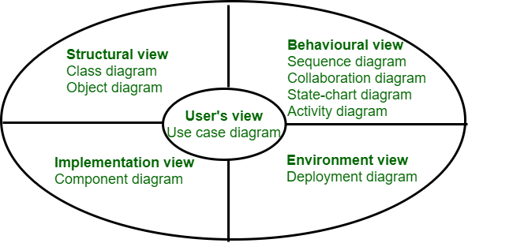
UML Diagrams
Made By: Team WAKINS
Supervised By: Abdurazzag AlMiladi

Slide 2
Introduction
Use Case
Sequence
Class
Activity
State
Component

Slide 3
Use-Case Diagram
Use-case diagrams are used to depict the functional requirements of a system. They focus on the interactions between users (actors) and the system itself. Depict specific functionalities that the system must perform. Use-case diagrams are employed during the early stages of software development to define and clarify system requirements.
They serve as a high-level view of the system's functionality and help in communication between stakeholders. Use-case diagrams do not provide detailed information about the inner workings of the system.

Slide 4
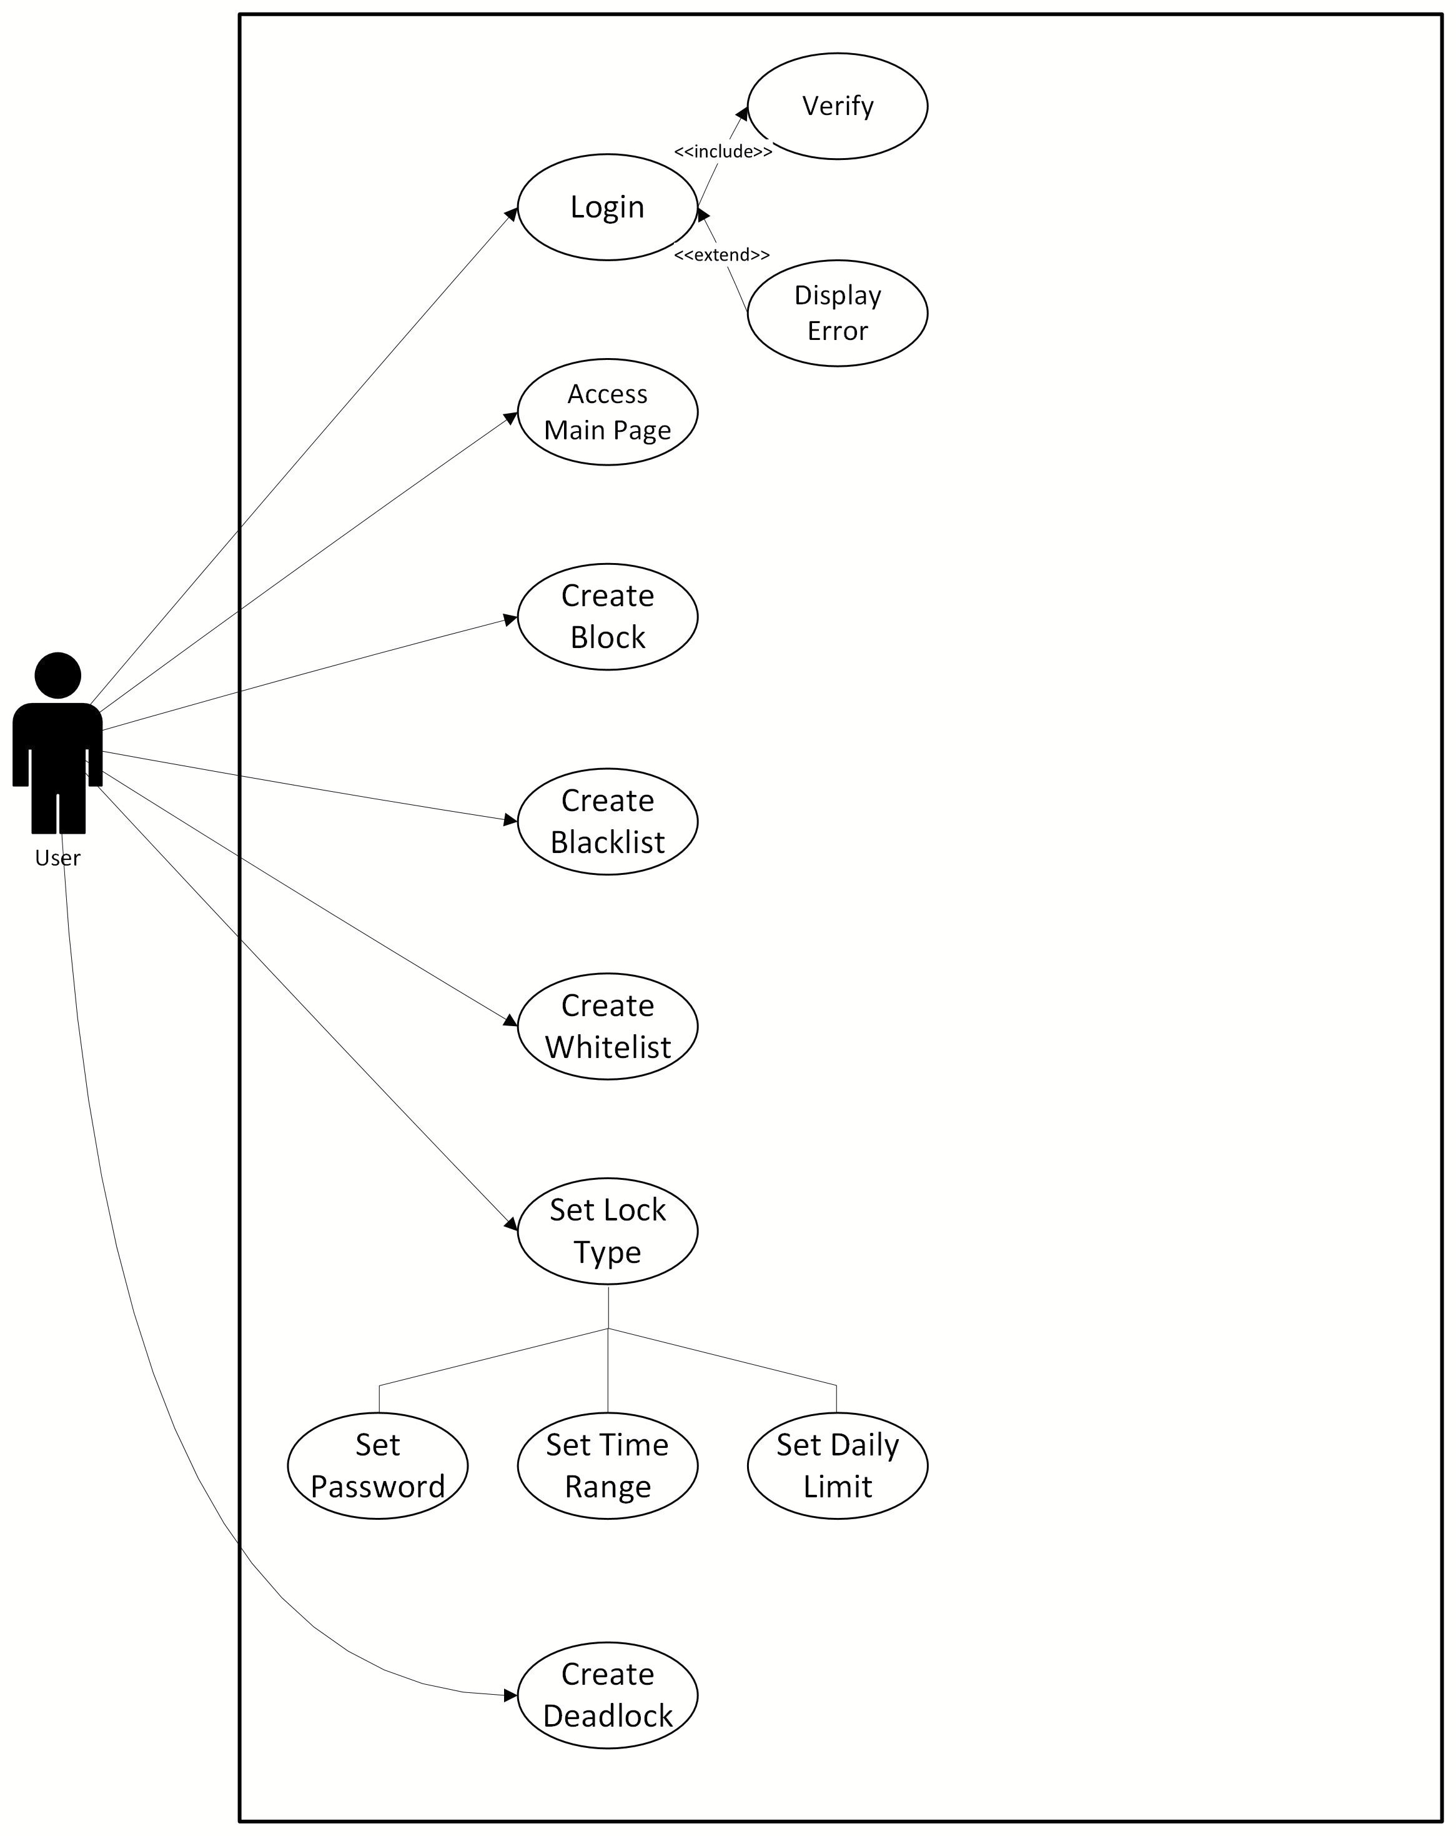
Use-Case Diagram

Slide 5
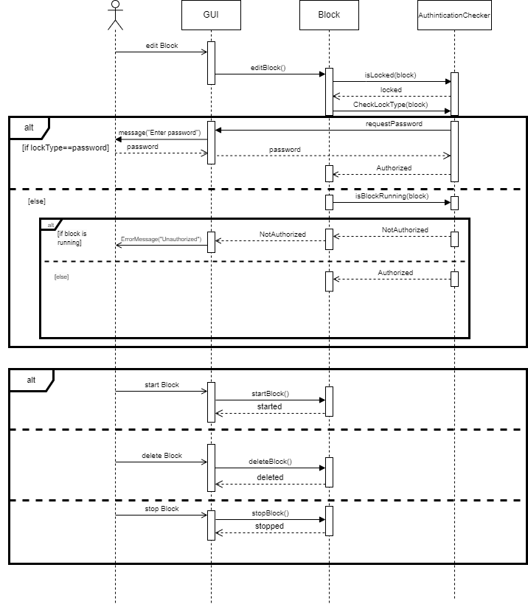
Sequence Diagram

Slide 6
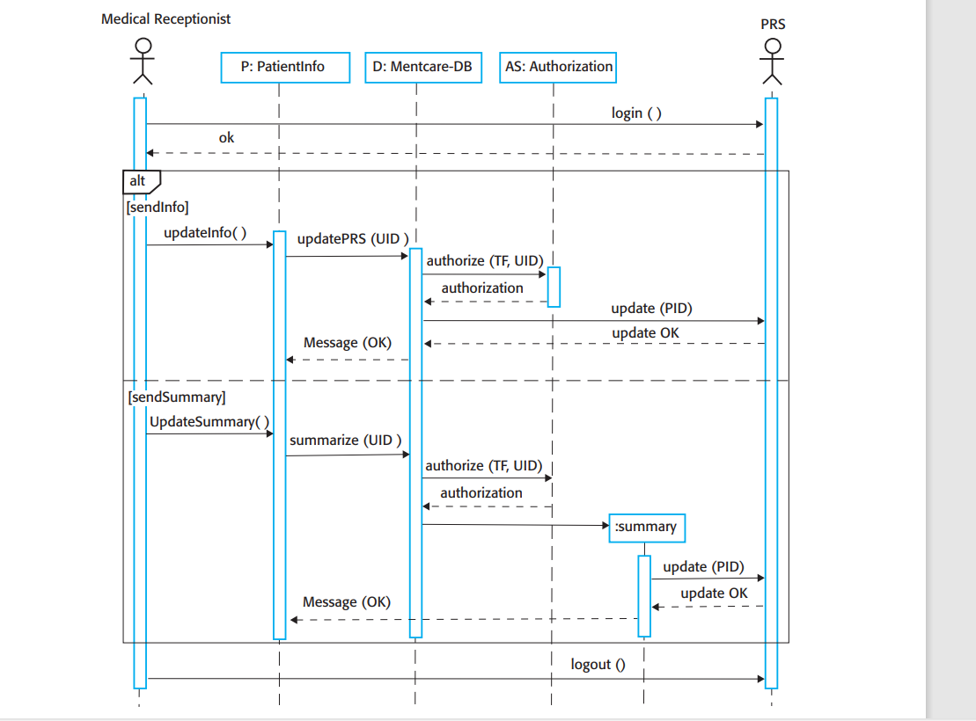
Sequence Diagram
Two additional features:
1-Multiple actors:
-Medical Receptionist
-PRS
2-Object instantiation
-Summary

Slide 7
Class Diagrams
Class diagrams
are part of a language called Unified Modelling Language (UML), which is like a common language used by designers to draw pictures that show different parts of systems that use objects.
Attributes
are traits or properties of an object in a class. They show what an object knows or has. For example, in a car class, attributes like colour, model, and year define what each car object looks like or what features it has.
Class diagrams
are a fundamental tool in software engineering used to visually represent the structure and relationships between classes in a system.
Methods
are actions that objects in a class know how to do. For instance, in a car class, methods like 'startEngine()' or 'changeGear()' show what a car can do, like starting the engine or shifting gears.
Classes
Represented by boxes, classes encapsulate data and behaviours (attributes and methods) of objects.
Relationships
Display connections between classes, such as associations, dependencies, inheritance, and more.

Slide 8
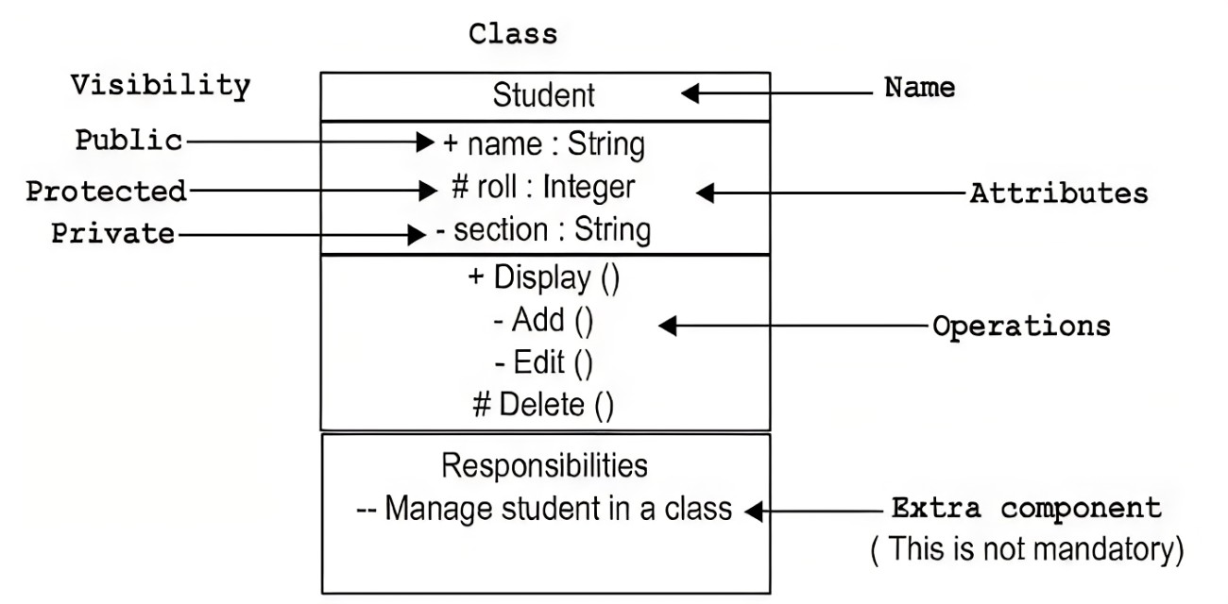
Visibility notations (public, private, protected) indicate the accessibility of attributes and methods within a class.
'+' (public): Public attributes/methods are accessible from anywhere, both within and outside the class.
'-' (private): Private attributes/methods are only accessible within the class itself.
'#' (protected): Protected attributes/methods are accessible within the class and its subclasses (in inheritance).
Importance
of Class diagrams in Software Engineering
Design Visualization: Class diagrams are like maps that make it easy for everyone to see and talk about how a system is built. They help folks understand complex designs without getting lost in the details.
System Planning and Analysis: Class diagrams act like a planning tool at the beginning of making something new. They help figure out what pieces are needed, how they connect, and how they work together before building anything.
Code Generation: They serve as a blueprint for implementation, guiding developers in writing code and establishing relationships between classes in the actual software.
Documentation: Class diagrams serve as valuable documentation for future reference, enabling maintenance and updates in software systems over time.

Slide 9
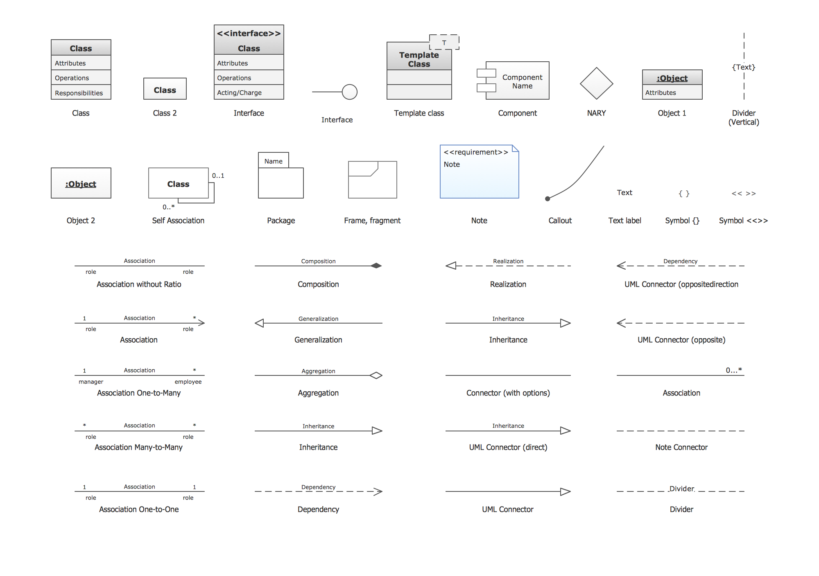
Components
of Class Diagrams Class Relationships

Slide 10
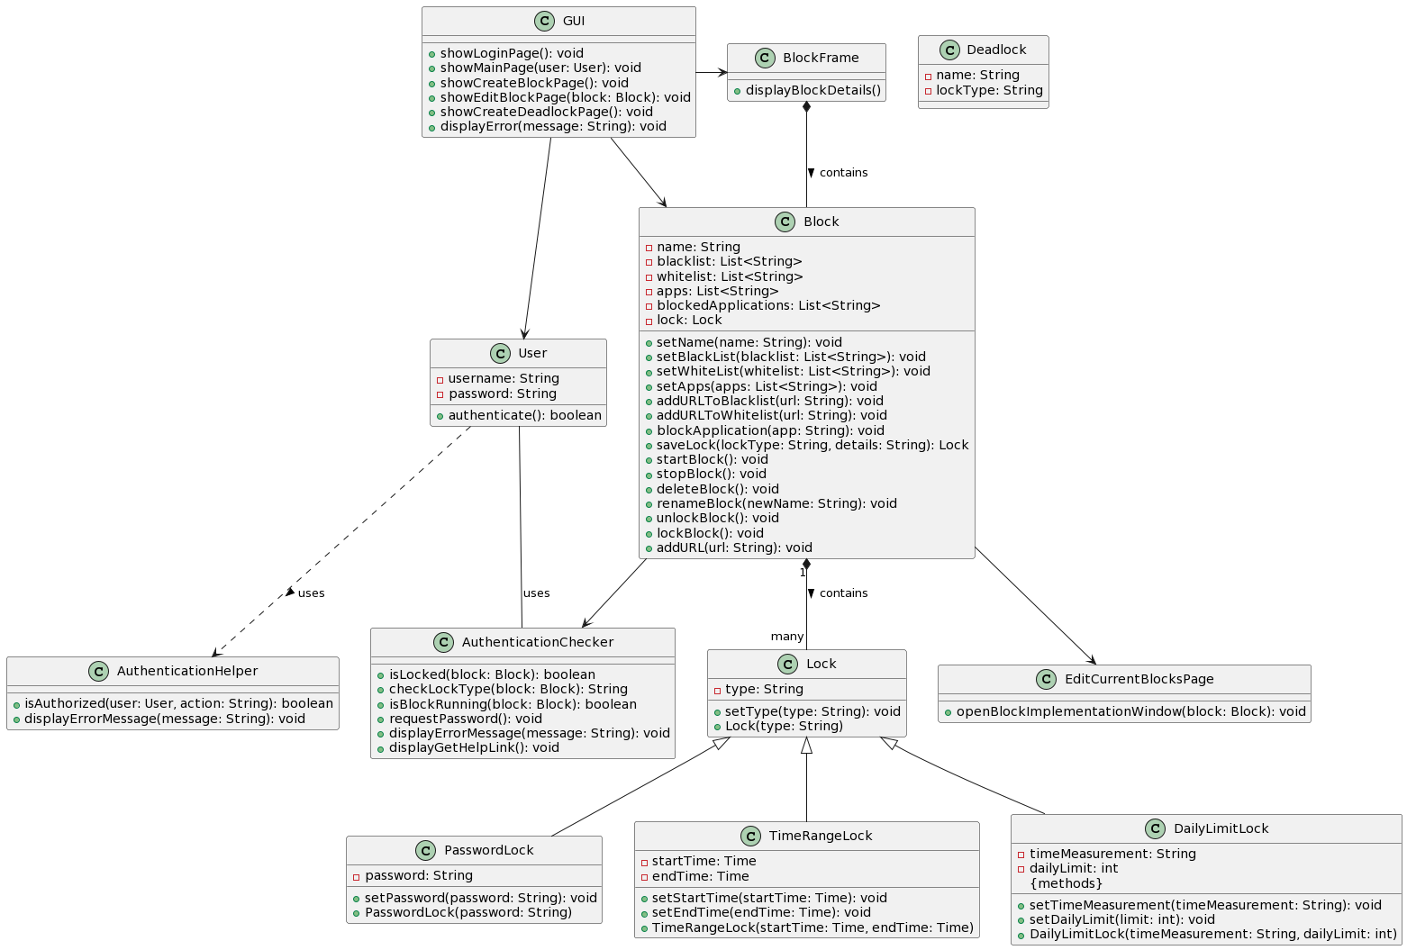
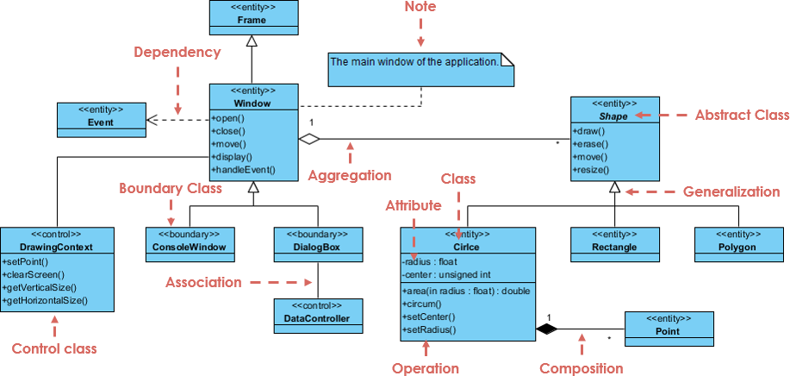
Real-World Example
Class diagrams are like blueprints for software. They help everyone understand how different parts of a program work together, making it easier to design, build, and talk about software.

Slide 11
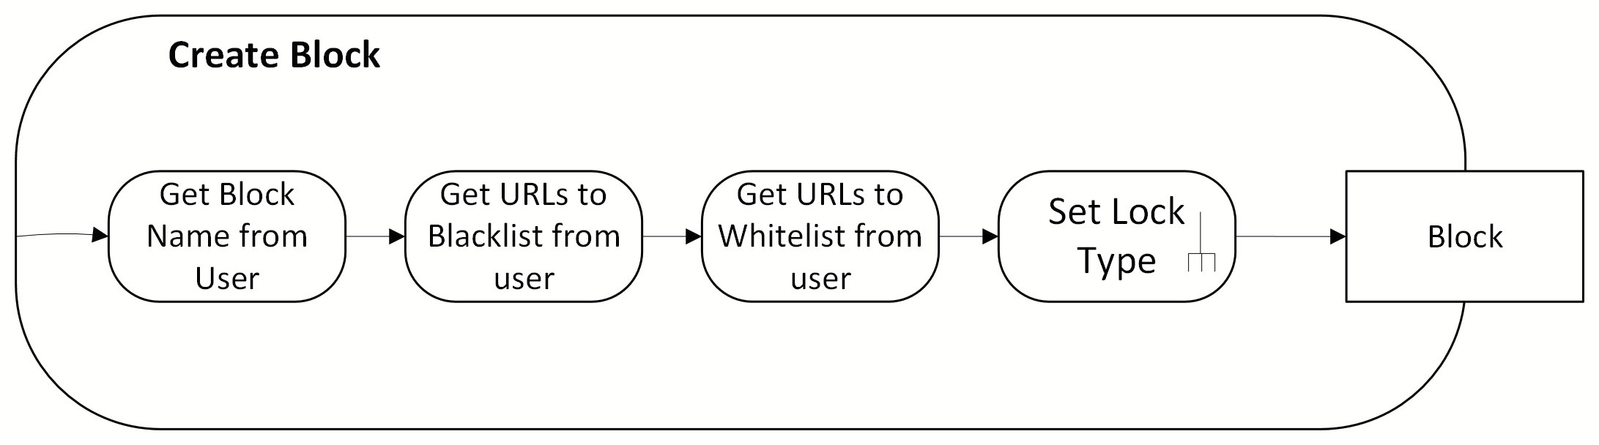
Activity Diagram

Slide 12
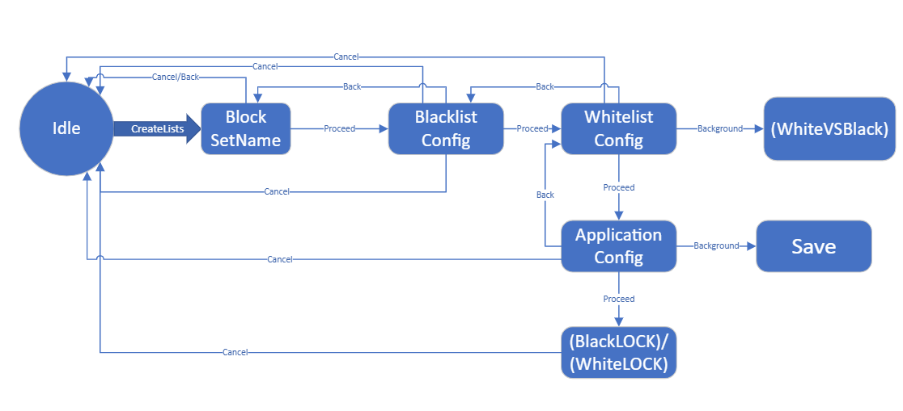
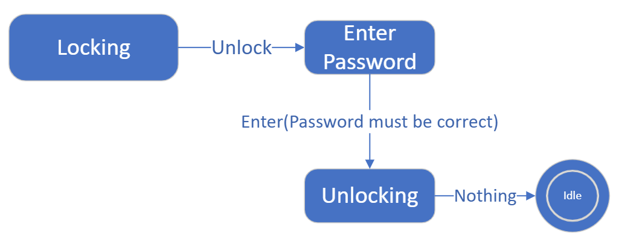
State Machine Diagram
Action
Transition
State
Guard
When “Action” happens, A “Transition” occurs to change from one “State” to the other. IFF “Guard” is true

Slide 13
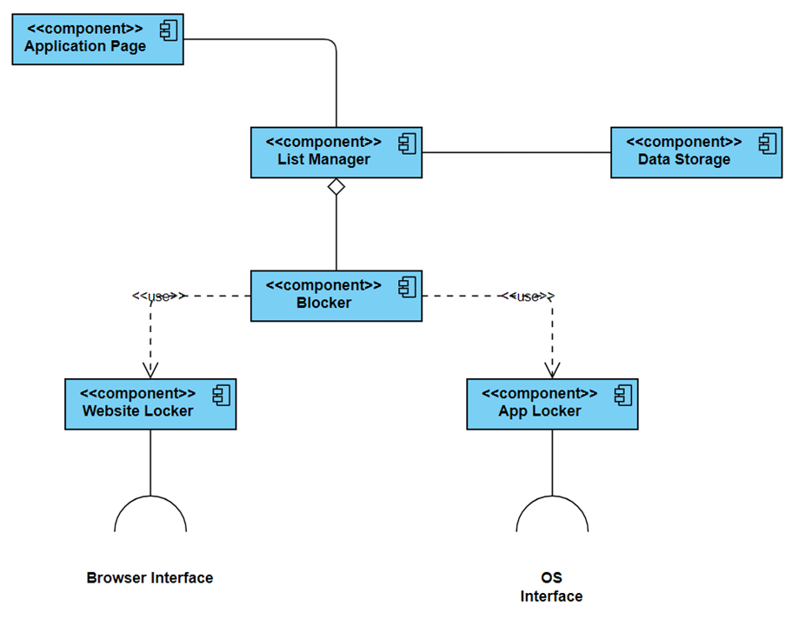
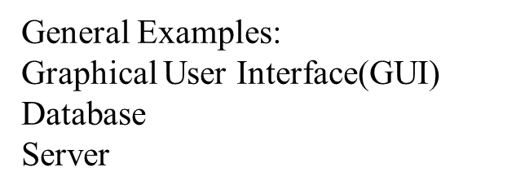
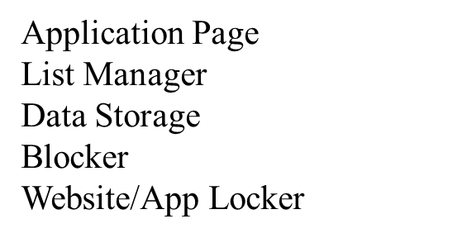

Component Diagram

Slide 14


Conclusion
Tips for creating a UML Diagram:
Understanding the type of diagram
Understanding the task at hand
Visualizing the layout
Be simple
Maintain consistency

Slide 15




